Slide 1
Hands-On with the Scientific Method Road to Teaching Conference Fall 2012
Presented by Barbara Finnell

Slide 2
Scientific Method
On your pre-assessment paper please list what you remember of the six steps of the scientific method. Put it to the side.
Let’s practice it.
Move to groups of four when possible. Get books, 2 per group

Slide 3
What is your experience?
What do you remember about the Scientific Method?
Usually dry and calculated
Rehearsing a lab with a lot of repetition and no new findings
Do this because it’s what you do, not because you are inspired
This experience turns that experience upside down
Let’s go over a few ground rules though

Slide 4
Safety with science
Follow instructions
Be clam and careful
Don’t taste things
Smell substances like a chemist
Protect your eyes
Tell your teacher if you have allergies
Report all spills, accidents and injuries to your teacher
Wash you hands after class
Never mix chemicals without permission

Slide 5
Chemical Reactions
Look through the Chemical Reactions Everywhere book with a partner.
What type of reactions did you find?
Get materials
Observe the materials, remember how we smell chemicals.

Slide 6
Experiment One
Person #1, place 2 scoops of Calcium Chloride in a zip bag and label the bag with “2 scoops CaCl”
Person #2, place 1 scoop of Baking soda into the same bag. Add “1 scoop Baking Soda” to bag. Get out most of the air
Person #3 measure 10 ml of Phenol Red and write it on the bag. Don’t add it
Person #4 when I say “mix” put the Phenol red in the bag and zip it closed.

Slide 7
Scientific Method
Step One-Ask a question
Together as a group discuss what happened.
What questions do you have about what happened and how.
Write them down on your sheet.
Are there any questions you have about the HYG reaction that you can TEST? For instance, today we can guess what phenol red is but can test what it is.
What question will you settle on?
How will you test it?

Slide 8
Scientific Method
Step Two: Do Background Research
In this case we are going to pull from our own background as our research.
Do we know anything about these chemicals?
Share what you know
Does any group want to change their question or how they will test it?

Slide 9
Scientific Method
Step Three: Construct a hypothesis
Make a prediction on your paper about what you will do and what you think will happen.
Create a recipe that you will test to see if it will make the change you are hoping for.
2 scoops CaCl
No Baking soda
10 ml phenol red
We think it will turn red and not have gas present

Slide 10
Scientific Method
Step Four: Test your hypothesis by experiment
Conduct your experiment and record your data
So take your supplies and go ahead with your experiment.
Try letting different people use different chemicals from last time.

Slide 11
Scientific Method
Step Five: Analyze data and draw conclusions
What do you think about what you found?
What evidence do you have?
What did each group find?

Slide 12
Scientific Method
Step six: Communicate Results
Share with others what you found.
Share your conclusions
What would you be interested in trying as next steps.
Were you correct?

Slide 13
With faculty

Slide 14
With my children

Slide 15
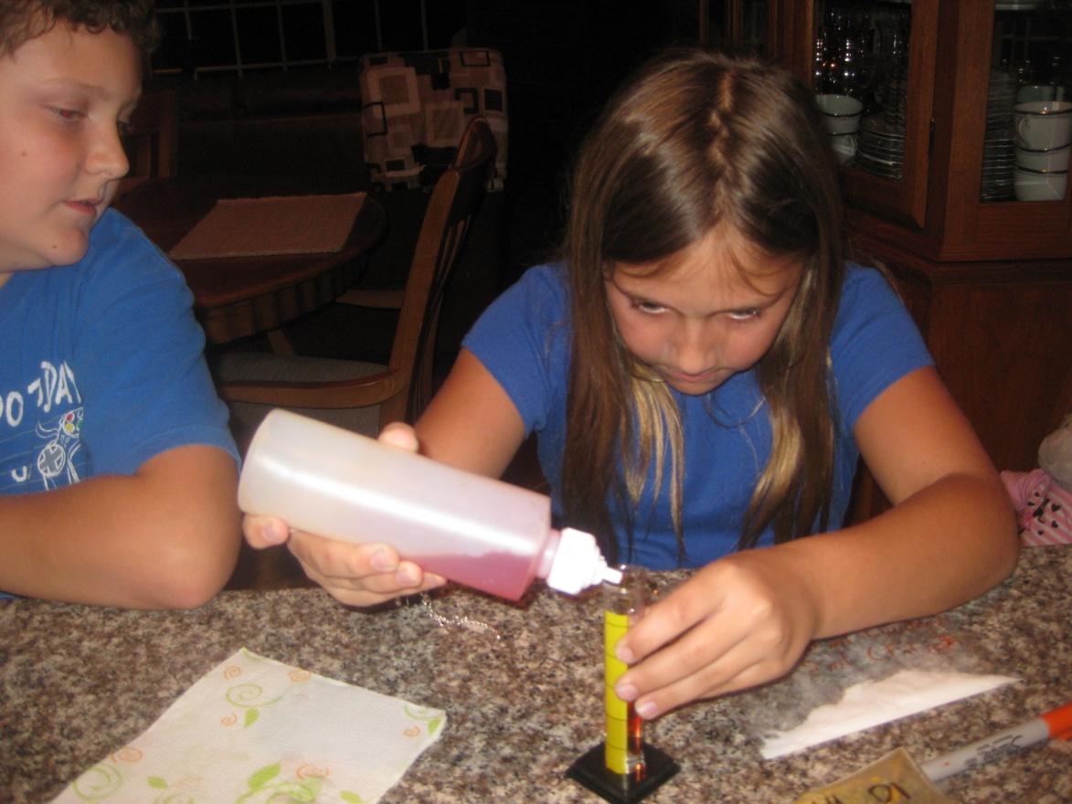
Serious scientists

Slide 16
Yup. . . We really kept experimenting

Slide 17
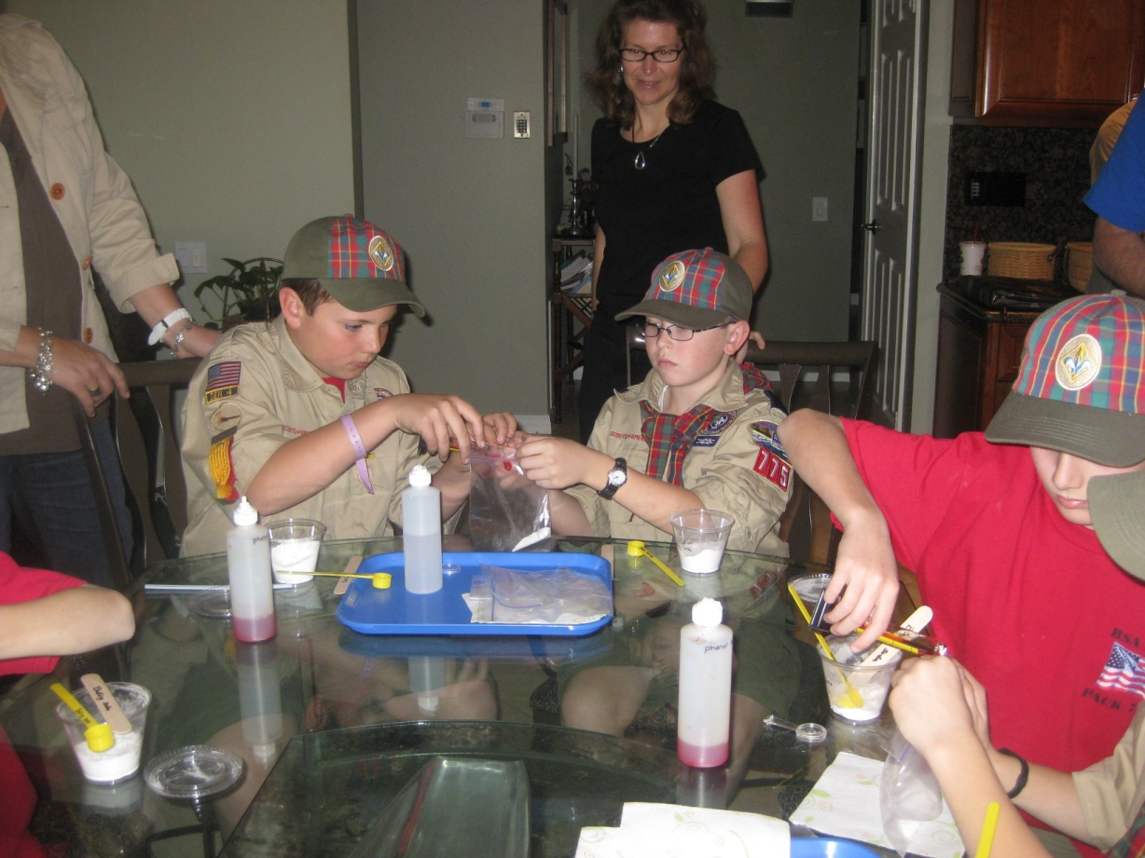
And oh yes, with the boy scouts

Slide 18
Trying it out with standard appropriate 4th/5th graders

Slide 19
Try it again
Do you have another alteration to your question?
Try it one more time.
What would you try next time?

Slide 20
www.scienceandliteracy.org
Take out your pre-assessment card
Put away your notes ☺
Write down the steps of the Scientific method on the card
Roots of Reading/Seeds of Science
by Delta

